Slide 1
Test management
Prof. Durga Prasad Mohapatra
Professor
Dept. of CSE, NIT Rourkela

Slide 2
Test Management
Test management is concerned with both test resource and test environment management.
It is the role of test management to ensure that new or modified service products meet the business requirements for which they have been developed or enhanced.

Slide 3
Key elements of test management
Test organization.
Test planning.
Detailed test design and test specifications.
Test monitoring and assessment.
Product quality assurance.

Slide 4
Test organization
It is the process of setting up and managing a suitable test organizational structure and defining explicit roles.
The project framework under which the testing activities will be carried out is reviewed, high-level test phase plans are prepared, and resource schedules are considered.
Test organization also involves the determination of configuration standards and defining the test environment.

Slide 5
Test planning
The requirements definition and design specifications facilitate the identification of major test items and these may necessitate updating the test strategy.
A detailed test plan and schedule is prepared with key test responsibilities being indicated.

Slide 6
Detailed test design and test specifications
A detailed design is the process of designing a meaningful and useful structure for the tests as a whole.
It specifies the details of the test approach for a software functionality or feature and identifying the associated test cases.

Slide 7
Test monitoring and assessment
It is the ongoing monitoring and assessment to check the integrity of development and construction.
The status of configuration items should be reviewed against the phase plans and the test progress reports prepared, to ensure the verification and validation activities are correct.

Slide 8
Product quality assurance
The decision to negotiate the acceptance testing program and the release and commissioning of the service product is subject to the 'product assurance' role being satisfied with the outcome of the verification and validation activities.
Product assurance may oversee some of the test activity and may participate in process reviews.

Slide 9
Test Organization I
Since testing is viewed as a process, it must have an organization such that a testing group works for better testing and high quality software.
Test Organization I

Slide 10
The testing group activities:
Maintenance and application of test policies
Development and application of testing standards
Participation in requirement, design and code reviews
Test planning
Test execution
Test measurement
Test monitoring
Defect tracking
Acquisition of testing tools
Test reporting

Slide 11
Test Organization II
The staff members of such a testing group are called test specialists or test engineers or simply testers.
A tester is not a developer or an analyst.
He does not debug the code or repair.
He is responsible for ensuring that testing is effective and quality issues are being addressed.
The skills a tester should possess are
Personal and Managerial Skills
Technical Skills

Slide 12
Personal and Managerial Skills
Testers must be able to contribute in policy-making and planning the testing activities.
must be able to work in a team.
must be able to organize & monitor information, tasks, and people.
must be able to interact with other engineering professionals, software quality assurance staff, and clients.
should be capable of training & mentoring new testers.
should be creative, imaginative, and experiment-oriented.
must have written and oral communication skills.

Slide 13
Technical Skills I
Testers must be technically sound, capable of understanding software engineering principles and practices.
must be good in programming skills.
must have an understanding of testing basics, principles, and practices.
must have a good understanding and practice of testing strategies and methods to develop test cases.

Slide 14
Technical Skills II
must have the ability to plan, design, and execute test cases with the goal of logic coverage.
must have technical knowledge of networks, databases, operating systems, etc. needed to work in a project environment.
must have the knowledge of configuration mgt.
must have the knowledge of test-ware and the role of each document in the testing process.
must have knowledge about quality issues & standards.

Slide 15
Structure of Testing Group
Testing is an important part of any software project.
One or two testers are not sufficient to perform testing, especially if the project is too complex and large.
Therefore, many testers are required at various levels.
Figure 1 shows different types of testers in a hierarchy.

Slide 16
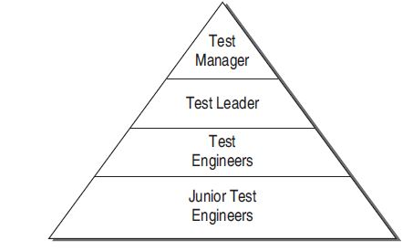
Structure of Testing Group contd…..
Figure 1: Testing Group Hierarchy

Slide 17
Responsibilities of Test Manager
He is the key person in testing group who will interact with project management, quality assurance, and marketing staff.
Takes responsibility for making test strategies with detailed master planning and schedule.
Interacts with customers regarding quality issues.
Acquires all the testing resources including tools.
Monitors progress of testing & controls the events.
Participates in all static verification meetings.
Hires and evaluates the test team members.

Slide 18
Responsibilities of Test Leader
Planning testing tasks given by the test manager.
Assigning testing tasks to test engineers who are working under him.
Supervising test engineers. (prime responsibility)
Acquires all the testing resources including tools.
Helping the test engineers in test case design, execution, and reporting.
Providing tool training, if required.
Interacting with customers.

Slide 19
Responsibilities of Test Engineers
Designing test cases.
Developing test harness.
Set-up test laboratories and environment.
Maintain the test and defect repositories.

Slide 20
Junior Test Engineers
Junior test engineers are newly hired testers.
They usually are trained about the test strategy, test process, and testing tools.
They participate in test design and execution with experienced test engineers.

Slide 21
Test Planning
According to the test process as discussed in STLC, testing also needs planning as is needed in SDLC. Since software projects become uncontrolled if not planned properly, the testing process is also not effective if not planned earlier.
Moreover, if testing is not effective in a software project, it also affects the final software product. Therefore, for a quality software, testing activities must be planned as soon as the project planning starts.
A test plan is defined as a document that describes the scope, approach, resources, and schedule of intended testing activities.

Slide 22
Test Planning cont…..
Test plan is driven with the business goals of the product. In order to meet a set of goals, the test plan identifies the followings:
Test items
Features to be tested
Testing tasks
Tools selection
Time and effort estimate
Who will do each task
Any risks
Milestones

Slide 23
Test Plan Identifier
Introduction
Test-Item to be tested
Features to be tested
Features not to be tested
Approach
Item Pass/Fail Criteria
Suspension criteria and resumption requirements
Test deliverables
Testing tasks
Environmental needs
Responsibilities
Staffing and training needs
Scheduling
Risks and contingencies
Testing costs
Approvals
Test Plan Components

Slide 24
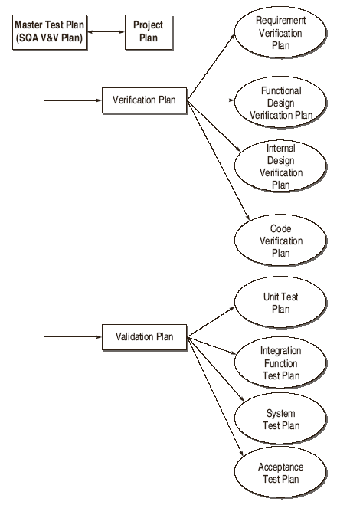
Test Plan Hierarchy

Slide 25
Detailed Test Design And Test Specifications
The ultimate goal of test management is to get the test cases executed.
Till now, test planning has not provided the test cases to be executed.
Detailed test designing for each validation activity maps the requirements or features to the actual test cases to be executed.
One way to map the features to their test cases is to analyse the following:
1. Requirement traceability
2. Design traceability
3. Code traceability

Slide 26
Test Design Specification
A test design specification should have the following components according to IEEE recommendation:
Identifier A unique identifier is assigned to each test design specification with a reference to its associated test plan.
Features to be tested The features or requirements to be tested are listed with reference to the items mentioned in SRS/SDD.
Approach refinements In the test plan, an approach to overall testing was discussed. Here, further details are added to the approach.
For example, special testing techniques to be used for generating test cases are explained.

Slide 27
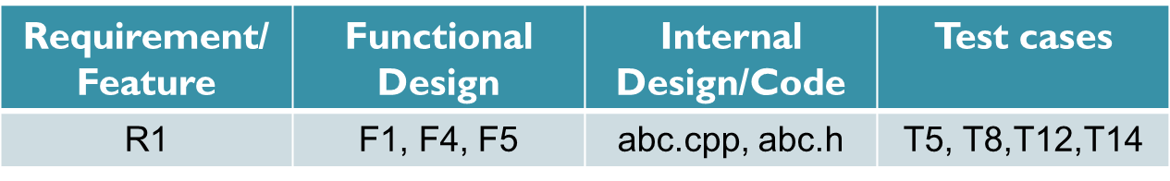
Test Design Specification
Test case identification The test cases to be executed for a particular feature/ function are identified here, as shown in Table 1.
Moreover, test procedures are also identified.
Table 1. Traceability matrix

Slide 28
Test Design Specification
The test cases contain input/output information and the test procedures contain the necessary steps to execute the tests.
Each test design specification is associated with test cases and test procedures.
A test case may be associated with more than one test design specifications.

Slide 29
Test Design Specification
Feature pass/fail criteria The criteria for determining whether the test for a feature has passed or failed, is described.

Slide 30
Test Case Specifications
Since the test design specifications have recognized the test cases to be executed, there is a need to define the test cases with complete specifications.
The test case specification document provides the actual values for input with expected outputs.
One test case can be used for many design specifications and may be re-used in other situations.
A test case specification should have the following components according to IEEE recommendation:

Slide 31
Test Case Specifications
Test case specification identifier A unique identifier is assigned to each test case specification with a reference to its associated test plan.
Purpose The purpose of designing and executing the test case should be mentioned here.
It refers to the functionality you want to check with this test case.

Slide 32
Test Case Specifications
Test items needed List the references to related documents that describe the items and features, e.g. SRS, SDD, and user manual.
Special environmental needs In this component, any special requirement in the form of hardware or software is recognized.
Any requirement of tool may also be specified.

Slide 33
Test Case Specifications
Special procedural requirements Describe any special condition or constraint to run the test case, if any.
Inter-case dependencies There may be a situation that some test cases are dependent on each other.
Therefore, previous test cases which should be run prior to the current test case must be specified.

Slide 34
Test Case Specifications
Input specifications This component specifies the actual inputs to be given while executing a test case.
The important thing while specifying the input values is
- not to generalize the values, rather specific values should be provided.
For example, if the input is in angle, then the angle should not be specified as a range between 0 and 360, but a specific value like 233 should be specified.
If there is any relationship between two or more input values, it should also be specified.

Slide 35
Test Case Specifications
Test procedure The step-wise procedure for executing the test case is described here.
Output specifications Whether a test case is successful or not is decided after comparing the output specifications with the actual outputs achieved.
Therefore, the output should be mentioned complete in all respects.
As in the case of input specifications, output specifications should also be provided in specific values.

Slide 36
Example
There is a system for railway reservation system. There are many functionalities in the system, as given below:
S. No. | Functionality | Function ID in SRS | Test cases
1 | Login the system | F3.4 | T1
2 | View reservation status | F3.5 | T2
3 | View train schedule | F3.6 | T3
4 | Reserve seat | F3.7 | T4
5 | Cancel seat | F3.8 | T5
6 | Exit the system | F3.9 | T6

Slide 37
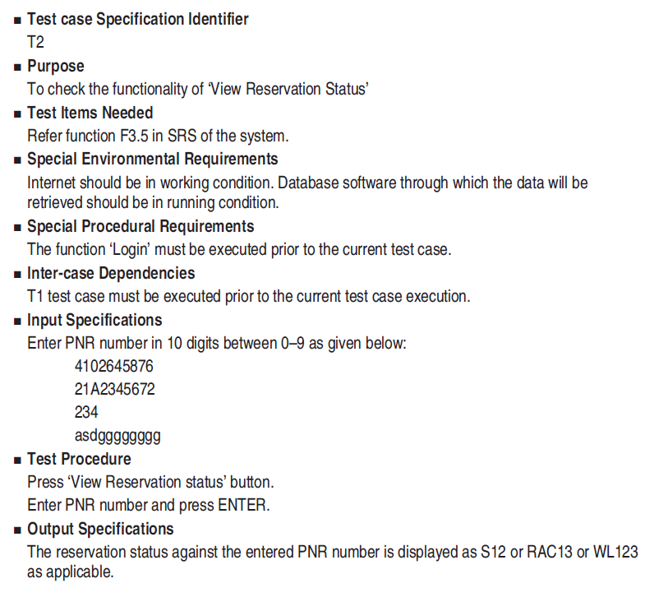
Test specification to ‘view reservation status’

Slide 38
Test Procedure Specifications
A test procedure is a sequence of steps required to carry out a test case or a specific task.
This can be a separate document or merged with a test case specification.

Slide 39
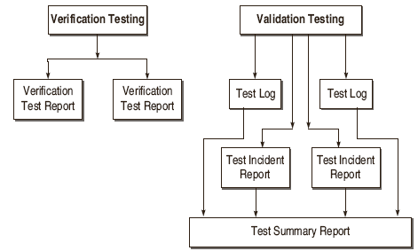
Test Result Specifications

Slide 40
Test Result Specifications
Test Log
Test log is a record of the testing events that take place during the test.
Test log is helpful for bug repair or regression testing.
The developer gets valuable clues from this test log, as it provides snapshots of failures.

Slide 41
Test Result Specifications
Format for preparing a test log according to IEEE:
Test log identifier
Description - Mention the items to be tested, their version number, and the environment in which testing is being performed.

Slide 42
Test Result Specifications
Activity & event entries - Mention the followings:
(i) Date
(ii) Author of the test
(iii) Test case ID
(iv) Name the personnel involved in testing
(v) For each execution, record the results and mention pass/fail status
(vi) Report any anomalous unexpected event, before or after the execution

Slide 43
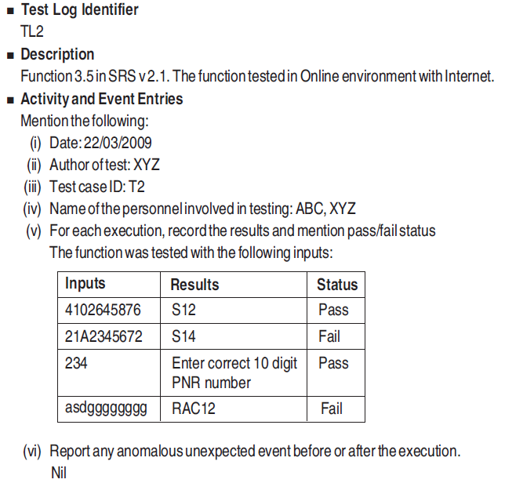
Sample test log for Example

Slide 44
Test Result Specifications
Test Incident Report
This is a form of bug report.
It is the report about any unexpected event during
testing which needs further investigation to resolve the bug.
Therefore, this report completely describes the execution of the event.
It not only reports the problem that has occurred but also compares the expected output with the actual results.

Slide 45
Test Result Specifications
Components of a test incident report
Test incident report identifier
Summary - Identify the test items involved, test cases/procedures, &the test log associated with this test.

Slide 46
Test Result Specifications
Incident description - It describes the followings:
(i) Date and time
(ii) Testing personnel names
(iii) Environment
(iv) Testing inputs
(v) Expected outputs
(vi) Actual outputs
(vii) Anomalies detected during the test
(viii) Attempts to repeat the same test

Slide 47
Test Result Specifications
Impact - The originator of this report will assign a severity value/rank to this incident so that the developer may know the impact of this problem and debug the critical problem first.

Slide 48
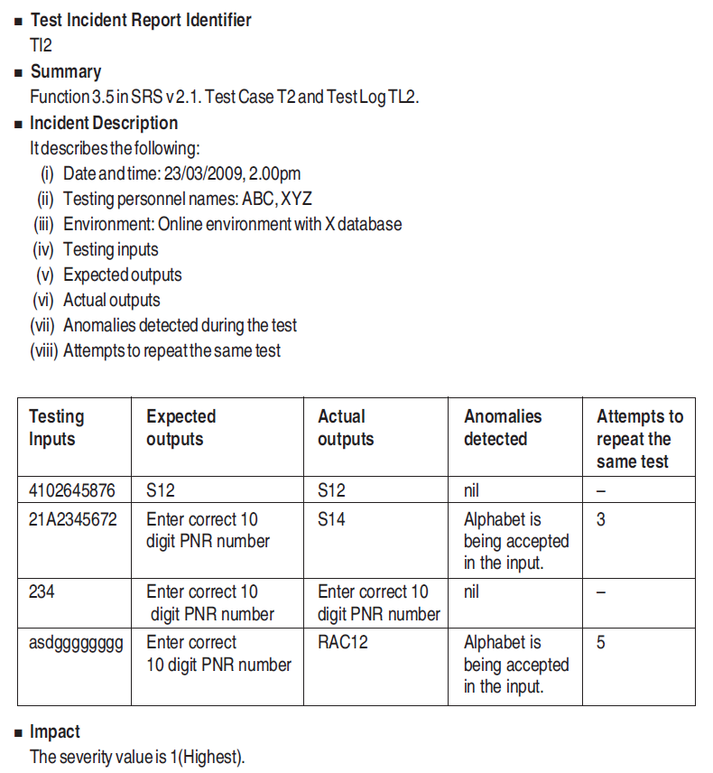
Sample test incident report
for Example

Slide 49
Test Result Specifications
Test Summary Report
It is basically an evaluation report prepared when the testing is over.
It is the summary of all the tests executed for a specific test design specification.
It can provide the measurement of how much testing efforts have been applied for the test.
It also becomes a historical database for future projects, as it provides information about the particular type of bugs observed.

Slide 50
Test Result Specifications
A test summary report contains the following components:
1. Test summary report identifier
2. Description Identify the test items being reported in this report with the test case/procedure ID.
3. Variances Mention any deviation from the test plans, test procedures, if any.

Slide 51
Test Result Specifications
Comprehensive statement The originator of this report compares the comprehensiveness of the testing efforts made with the test plans.
It describes what has been tested according to the plan and what has not been covered.

Slide 52
Test Result Specifications
Summary of results All the results are mentioned here with the resolved incidents and their solutions.
Unresolved incidents are also reported.
Evaluation Mention the status of the test results. If the status is fail, then mention its impact and severity level.

Slide 53
Test Result Specifications
Summary of activities All testing execution activities and events are mentioned with resource consumption, actual task durations, etc.
Approvals List the names of the persons who approve this document with their signatures and dates.

Slide 54
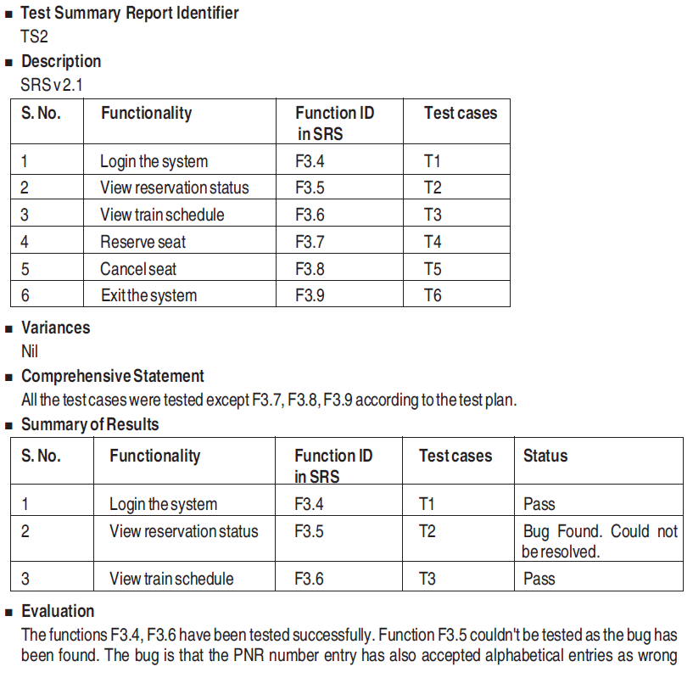
Test summary report for Example

Slide 55
Summary
Discussed the key elements of test management.
Presented the structure of testing group.
Explained the details of test planning.
Discussed detailed test design and test specifications.
Presented various testing reports such as
Test log
Test incidence report
Test summary report

Slide 56
References
Naresh Chauhan, Software Testing: Principles and Practices, (Chapter – 9), Second Edition, Oxford University Press, 2016.

Slide 57
Thank you

